Slide 1
Patient Room Monitoring System
Presented By Komal Rane

Slide 2
Agenda
Introduction
Literature Survey
Results
Working Circuit & Model
Conclusion
Future Scope
References

Slide 3
Introduction
There is a big loophole and in majority of cases lack of proper healthcare facilities to tackle the rising need by the patients.
This project provides a combination of process of sensing several gas levels in the air and also the ambient temperature and humidity along with light intensity, thus sensing the quality of the air and intensity of light.
The levels of the gases and the temperature is displayed on the Blynk panel which continuously shows the real time output values of the gas sensors, temperature and humidity sensor and LDR sensor.

Slide 4
Literature Survey
Continued deterioration of public health resources and poor environmental conditions is a major public health concern in developed and developing countries.
In the current scenario of technological developments the healthcare infrastructure is still underdeveloped and facing a lot of issues.
It is estimated that 2.4% of the deaths in the country are incurred due to improper hygiene and non-monitored medical facilities.

Slide 5
Results
The system is aimed at monitoring the temperature, air quality, humidity and light intensity in the room of the patient.
The major aim is to provide a monitored facility to avoid chances of any mishaps and to enhance our existing infrastructure.
The model is a robust solution which can efficiently detect the room temperature, humidity, air quality and light intensity.
It can be efficiently used as a room monitoring system especially in the medical fields where it can be deployed to monitor conditions of patient’s room

Slide 6
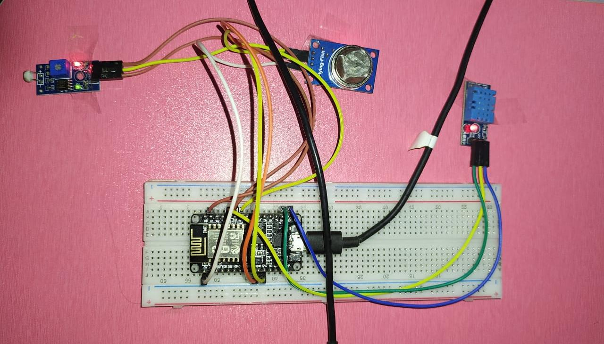
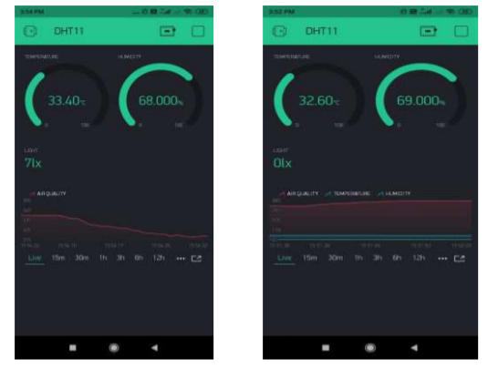
Working Circuit & Model
Circuit Diagram: Working On Blynk App:

Slide 7
Conclusion
In this project, a patient room monitoring system is developed that allows patients to be mobile in their social areas.
The system is intended to help monitor the room conditions of the patient like the air quality, room temperature and light intensity.
The main purpose of the device is to make sure that they get medical aid as soon as possible, in case of a possible discomfort.
So there will be an increased chance of survival of patients.

Slide 8
Future Scope
We can add a GPS module in IOT patient monitoring using Arduino MEGA. This GPS module will find out the position or the location of the patient using the longitude and latitude received. Then it will send this location to the cloud that is the IOT using the Wi-Fi module. Then doctors can find out the position of the patient in case they have to take some preventive action.
Nowadays people are suffering from BP and heart attacks so if we add BP, ECG, EEG sensors in this project. With the help of these sensors we will find Blood pressure and we will check heart condition. Wi-Fi is an external module connected to Arduino mega. It is better if it is built, so complexity can be reduced.

Slide 9
References
S. M. Riazul islam, Daehan kwak, MD. Humaun kabir, Mahmud hossain, and Kyung-sup kwak,” The Internet of Things for Health Care:A Comprehensive Survey” , DOI 10.1109/TDSC.2015.240699, IEEE Transactions.
Junaid Mohammed, Abhinav Thakral, Adrian Filip Ocneanu, Colin Jones, Chung-Horng Lung, Andy Adler,” Internet of Things: Remote Patient Monitoring Using Web Services and Cloud Computing”, 2014 IEEE International Conference on Internet of Things (iThings 2014), Green Computing and Communications (GreenCom2014), and CyberPhysical- pp 256-263, 2014

Slide 10
Thank You

